Slide 1

Document Clustering and ranking
PRESENTED BY:
K. SAI SHILPA(14131A1252)
A. SUPRIYA(14131A1202)
A.YEDUKONDALU(14131A1204)
G. SAI KRISHNA(14131A1226)
Under The Guidance Of S. Y. PAVAN KUMAR Sir

Slide 2


Introduction
1. Clustering
2. Indexing
3. HDFS
4. Ranking
Abstract
Existing System
Proposed System
Requirements
Diagrams
How it works?
Results
Test Cases
Advantage
Conclusion
References

Slide 3
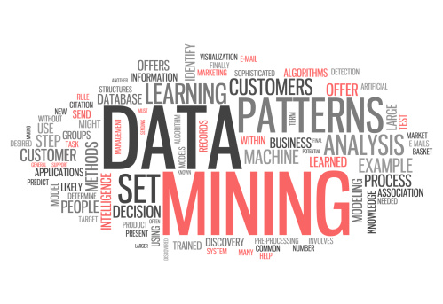
INTRODUCTION
There is a voluminous amount of data in the present world and additionally it is being incremented day by day so to retrieve the most related information among this ample of documents is being complex.
Whenever a user requests a query they are being resulted with the documents either relating to the title of the document or to the author of the document, but we propose a system in order to make the user get the result based on the data present among the available vast documents

Slide 4
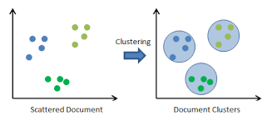
Clustering
Clustering is the process of partitioning a set of data objects (or observations) into subsets.
The subset is a cluster, such that objects in a cluster are similar to one another, yet dissimilar to objects in other clusters.
The set of clusters resulting from a cluster analysis can be referred to as a clustering.
Different clustering methods may generate different clustering on the same data set.

Slide 5

Indexing
Indexing collects, parses,
and stores data to facilitate
fast and accurate information retrieval.
The purpose of storing an index is to optimize speed and performance in finding relevant documents for a search query. Without an index, the search engine would scan every document in the corpus, which would require considerable time and computing power.
For example, while an index of 10,000 documents can be queried within milliseconds, a sequential scan of every word in 10,000 large documents could take hours.

Slide 6
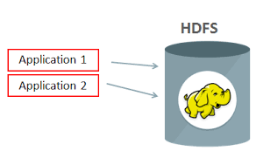
Hadoop Distributed File System
The Hadoop Distributed File
System (HDFS) is a
distributed file system
designed to run on
commodity hardware.
HDFS is highly fault-tolerant and is designed to be deployed on low-cost hardware. HDFS provides high throughput access to application data and is suitable for applications that have large data sets.

Slide 7
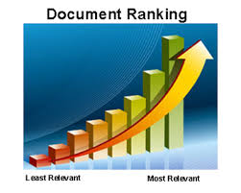
Ranking
Ranking of query results is
one of the fundamental
problems in information retrieval (IR).
Given a query q and a collection D of documents that match the query, the problem is to rank, that is, sort, the documents in D according to some criterion so that the "best" results appear early in the result list displayed to the user.
Classically, ranking criteria are phrased in terms of relevance of documents with respect to an information need expressed in the query.

Slide 8
Abstract
An application to collect the documents and retrieve the exact and relevant information among the document collection and clusters , based on the search query from the user.

Slide 9
Existing System
The existing system has a facility that is when given a query; it has to search the document based on the title and author details only.
This process may not always give us the best related documents, so the proposed system is designed such a way that it relates the documents based on the keyword given by the user.

Slide 10
Proposed System
We propose this work of document clustering and ranking, which is an automatic grouping of documents into clusters.
Retrieving the information and documents as per the user requested query(keyword) which would be relevant to what the user is expecting.

Slide 11

Software Requirements:
Ubuntu 16.04
Java 1.8
Hadoop 2.5.2
Java – The programming language to implement the creation of indices by analyzing the words in document, conversion of pdfs to text files and clustering.
Hadoop Distributed File System – HDFS provides high throughput access to application data and is suitable for applications that have large data sets.

Slide 12

Hardware Requirements
4GB RAM
1.7-2.4 GHz processor speed
500 GB HDD

Slide 13
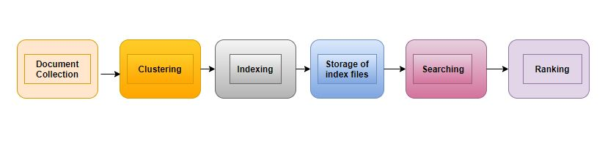
Data Flow Diagram
A data flow diagram (DFD) is a graphical representation of the flow of data through an information system, modeling its process aspects. It is often used as a preliminary step to create an overview of the system without going into great detail, which can later be elaborated. It can also be used for the visualization of data processing.
A DFD shows what kind of information will be input to and output from the system, how the data will advance through the system, and where the data will be stored.

Slide 14
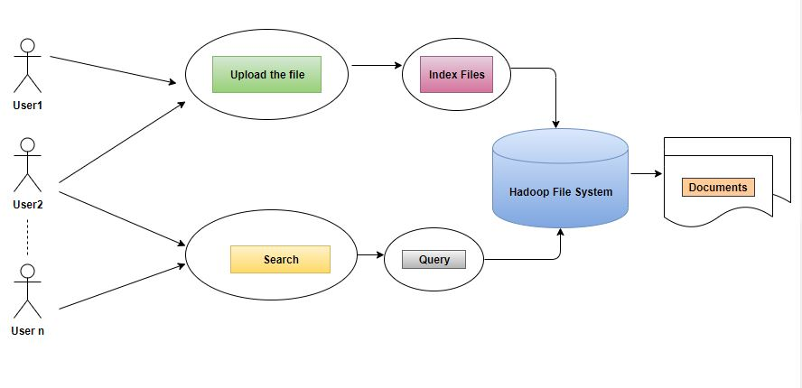
Usecase diagram
To model a system the most important aspect is to capture the dynamic behavior. These internal and external agents are known as actors. So use case diagrams are consists of actors, use cases and their relationships.

Slide 15

How it works ?
Firstly the user enters into the application they have 2 options either to insert the document or to search for any document.
In case of insertion, once a book is been uploaded, which we consider as pdf or text format, if it is pdf file we would convert it to text file, else we would proceed our analysis of the words present in the document.
We then tend to maintain the words which is to stored into the index file.
This index file is in turn helpful to us in retrieving the documents .

Slide 16
(Contd.)
In case of searching, when the user generates the query which can be either boolean, phrase, fuzzy, wildcard etc. then the index file is been searched for that query.
This index file helps us to decide the ranking of that word with respect to the documents present with us. Score is also being generated based on the query.
The maintenance of the index file is helpful in reducing the processing time of the searching.

Slide 17
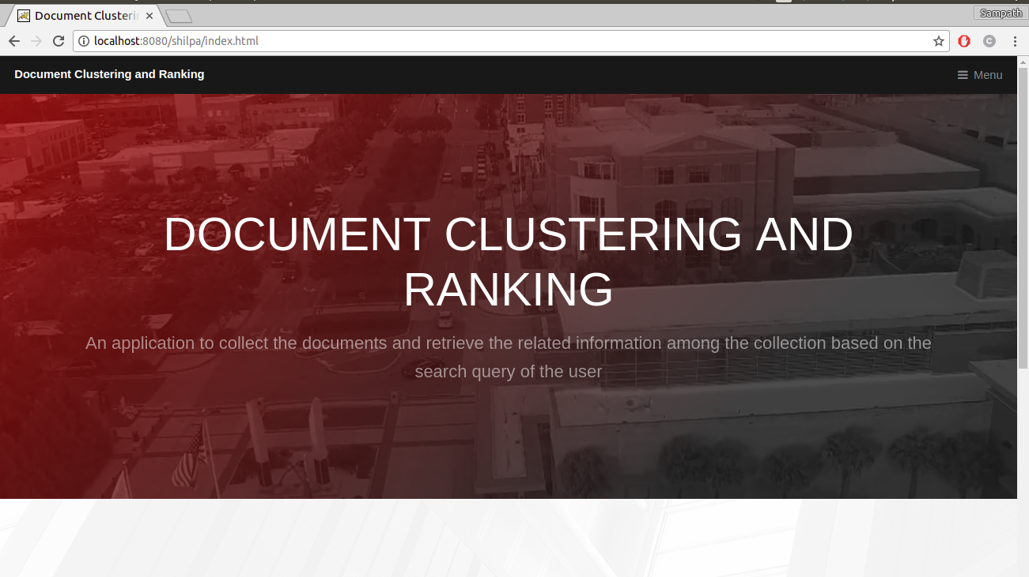
Result

Slide 18
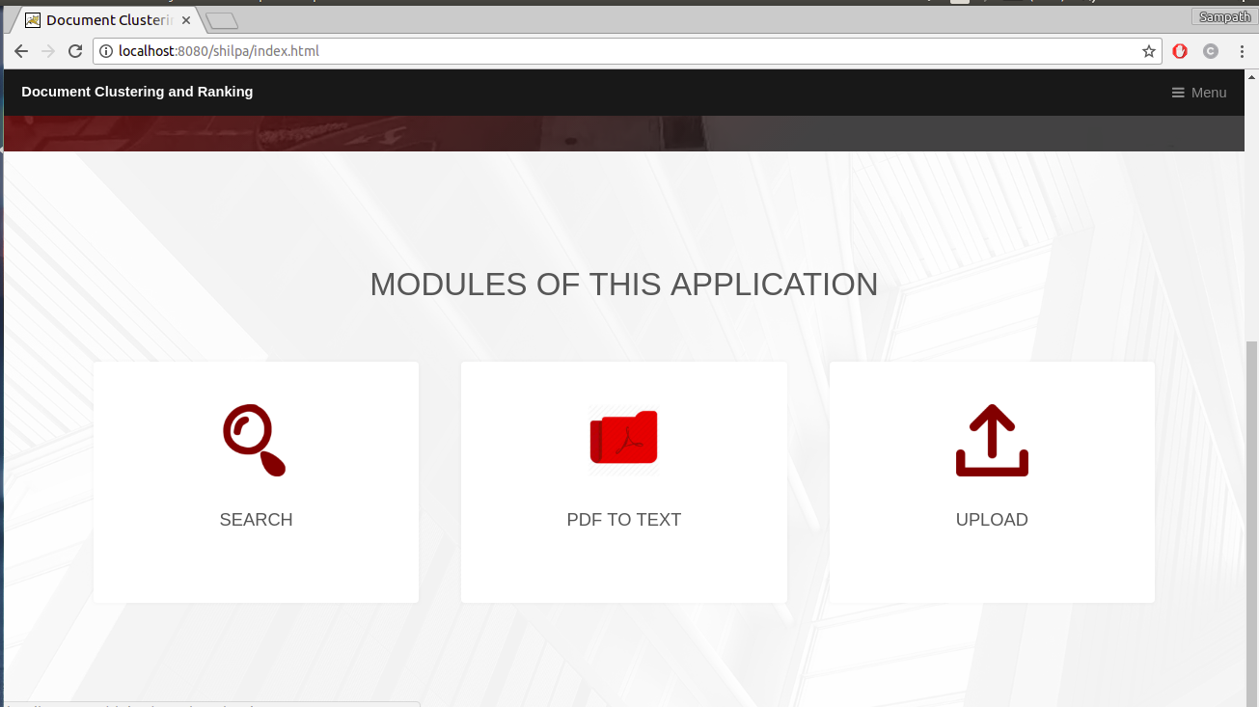

Slide 19
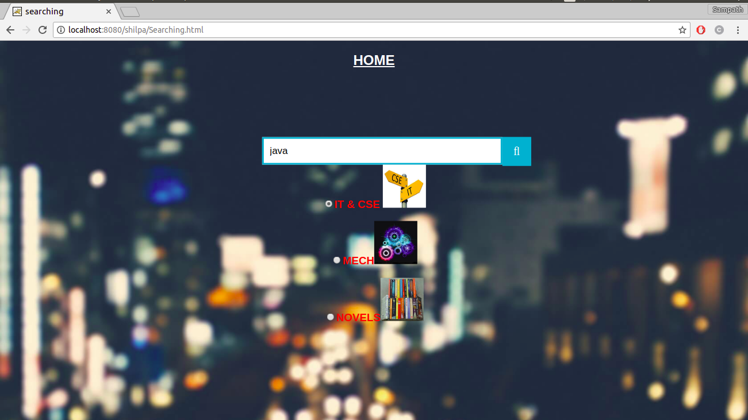
Term Query

Slide 20
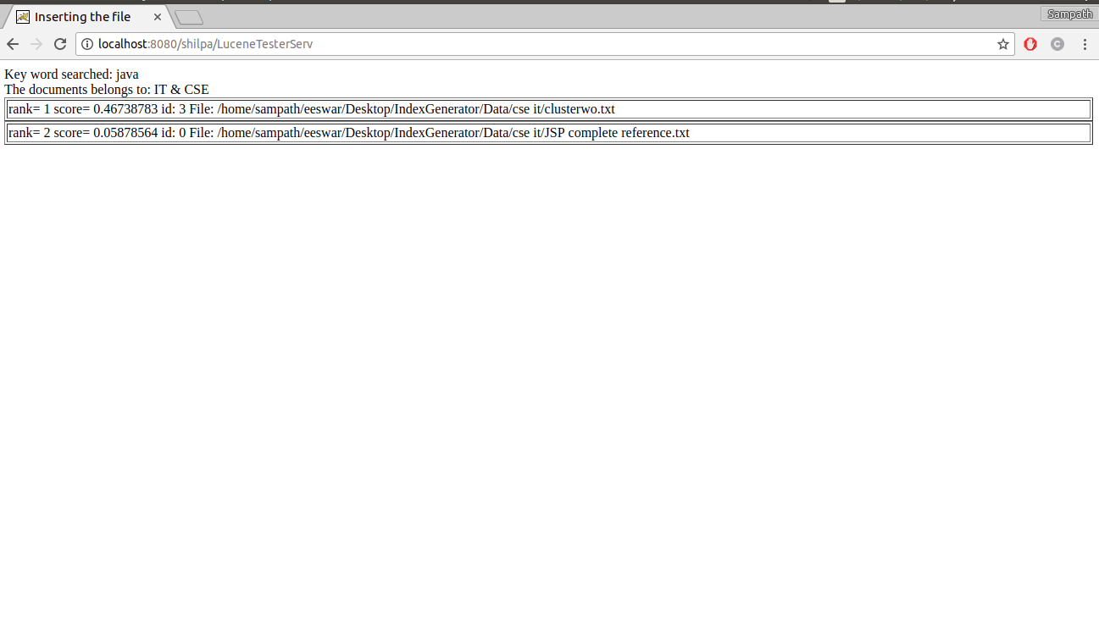

Slide 21

Boolean Query

Slide 22
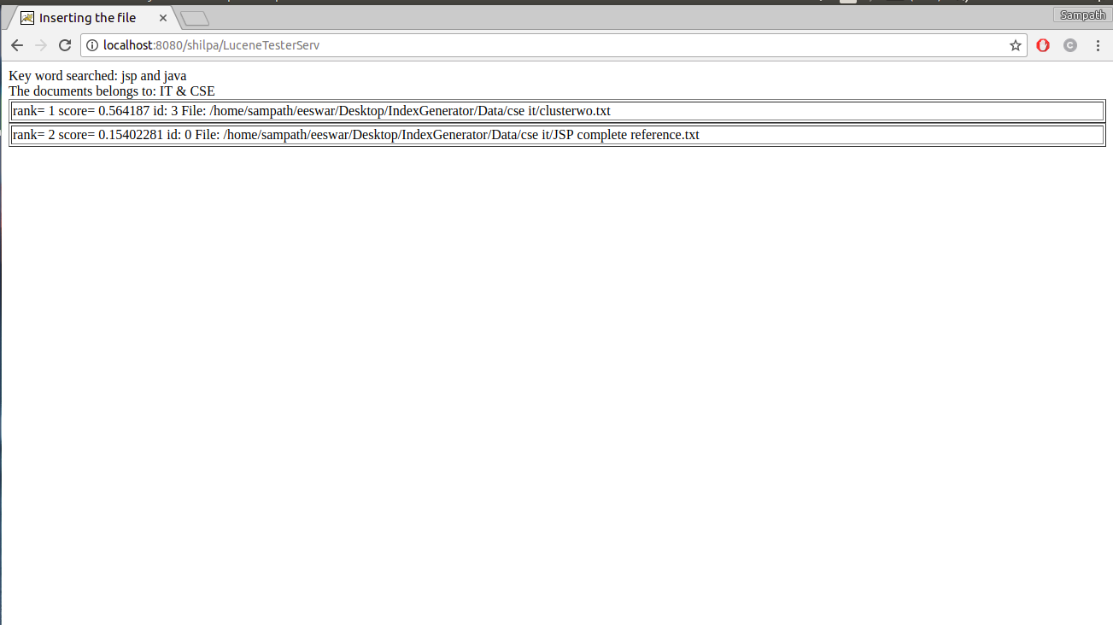

Slide 23
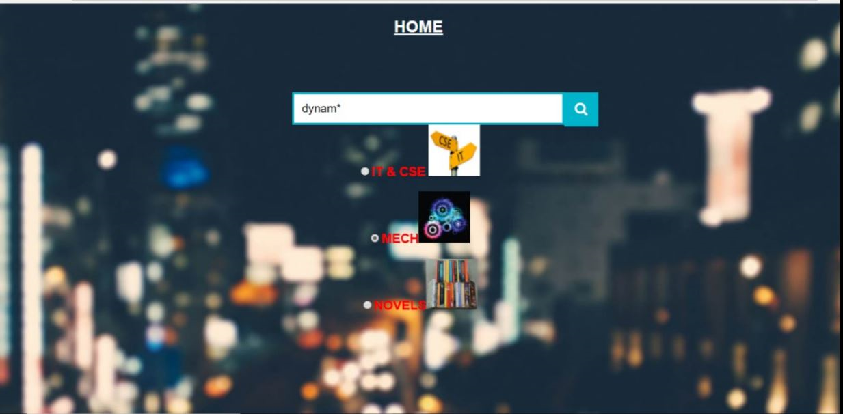
Wildcard Query

Slide 24
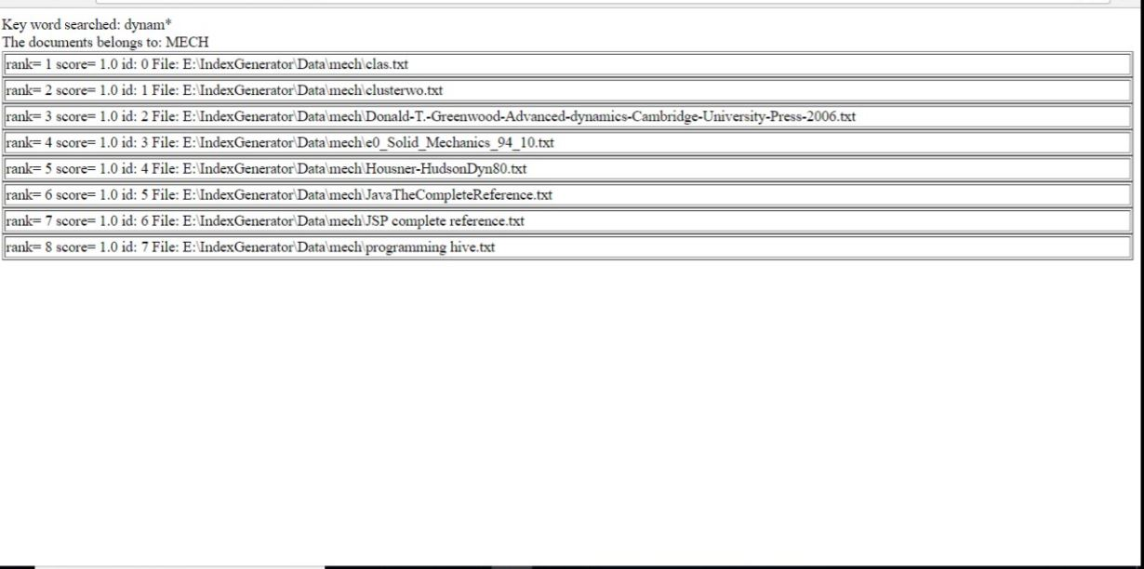

Slide 25
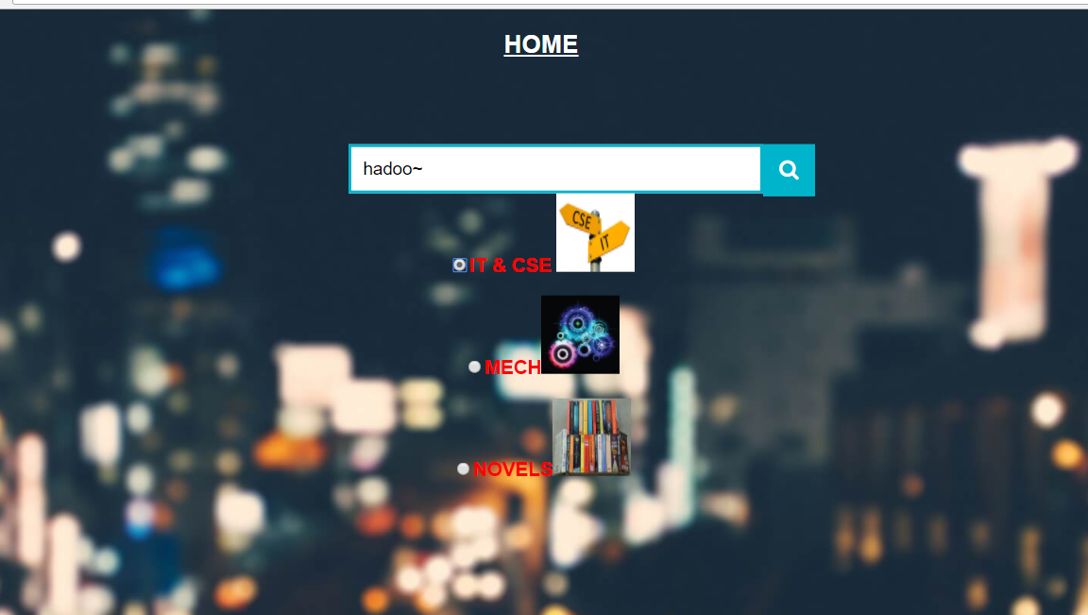
Fuzzy Query

Slide 26
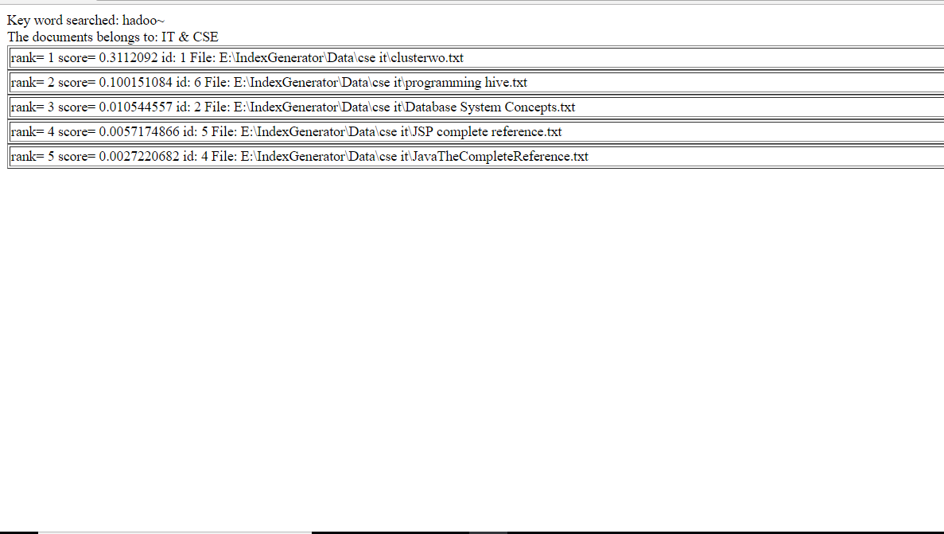

Slide 27
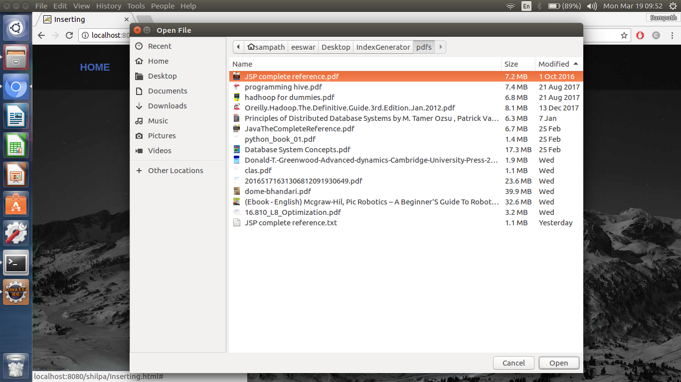

Slide 28
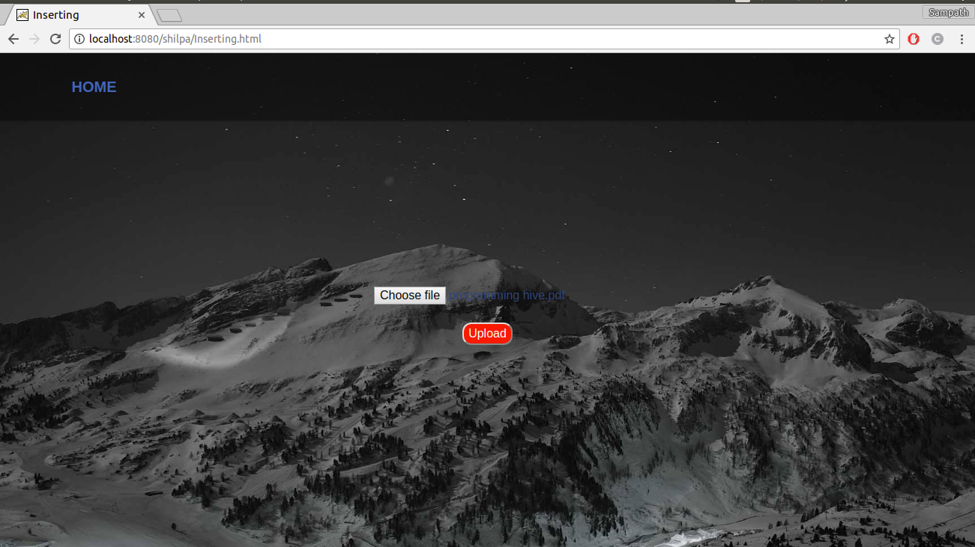

Slide 29
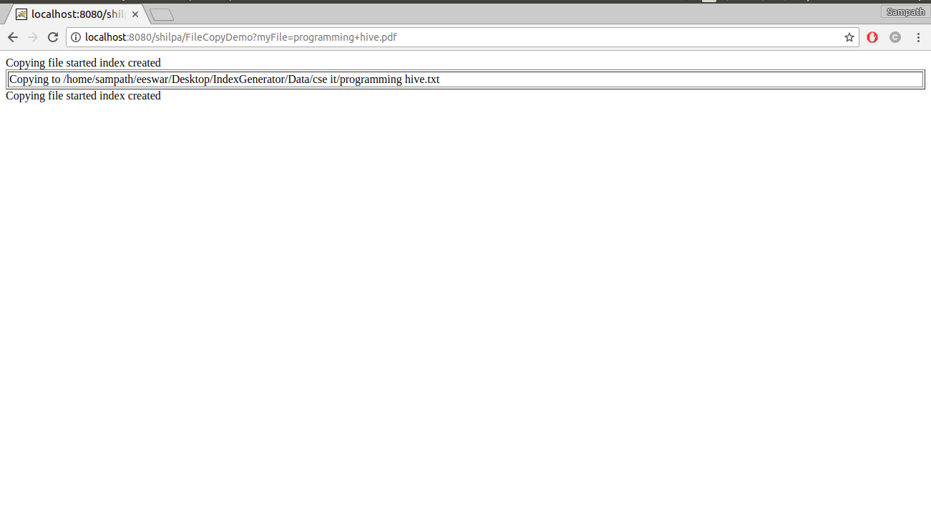

Slide 30
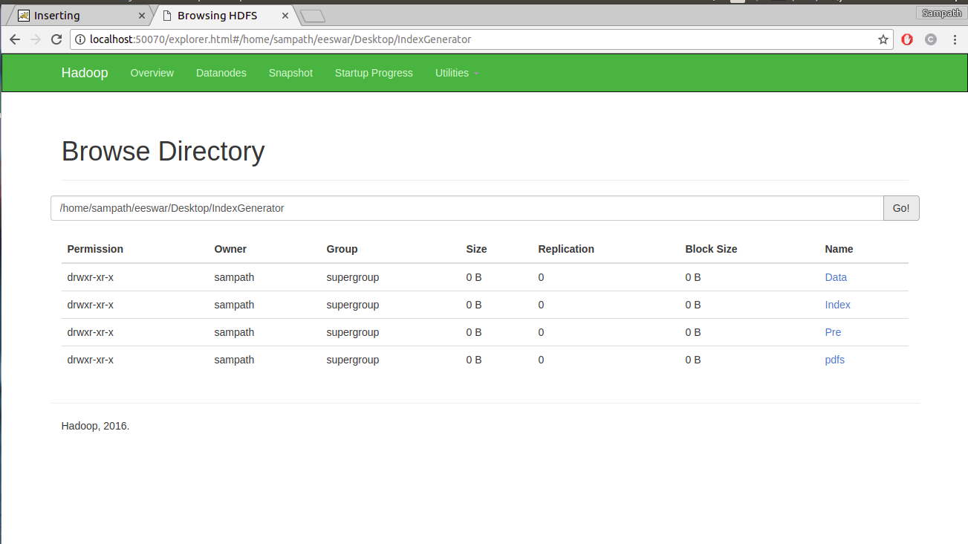
HDFS view of the data

Slide 31
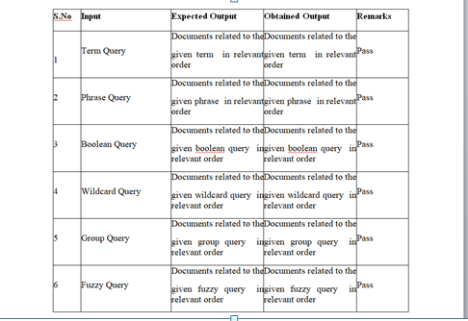
Test Cases

Slide 32

Advantages
Time for processing the documents would be reduced by maintaining the indices of all the non stop words which belongs to the documents.
This maintenance of the indices helps us to reduce the processing time for the rank based retrieval of the relevant documents among all the documents along with there scores.
The accurate results will be obtained as we maintain the updates documents.

Slide 33
Conclusion
This application ensures to collect the documents, form groups out of the given documents based upon the uploaded book consisting of the words in it by placing a file consisting of the predefined words allotted in the file, and later retrieve the exact and the most relevant document among the clusters, depending upon the search query from the user.
We are expecting to provide the user with the most relevant document for the given query through this application and pdf to text convertor as this application is purely text based and generally the eBooks are of pdf type.
The existing system has a facility that is when given a query; it searches only the title of the book and author of the book for the particular word given by the user. This process may not give the accurate result of what the user is expecting and we know that every user expects to retrieve the search result in less time.

Slide 34
References
Text References
Hadoop: The Definitive Guide, Third Edition by Tom White
Data Mining Concepts and Techniques Third Edition Jiawei Han University of Illinois at Urbana–Champaign Micheline Kamber Jian Pei Simon Fraser University
Web References
https://link.springer.com/chapter/10.1007/978-3-319-03095-1_4
http://ieeexplore.ieee.org/document/7969447/figures

Slide 35
